Slide 1
Types of Grammars - Chomsky hierarchy of languages
Venn Diagram of Grammar Types:
Type 0 –Unrestricted G ( Phrase-structure Grammars)
Type 1 – Context-Sensitive G
Type 2 – Context-Free G
Type 3 – Regular
Grammar

Slide 2
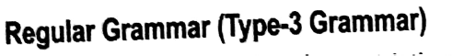
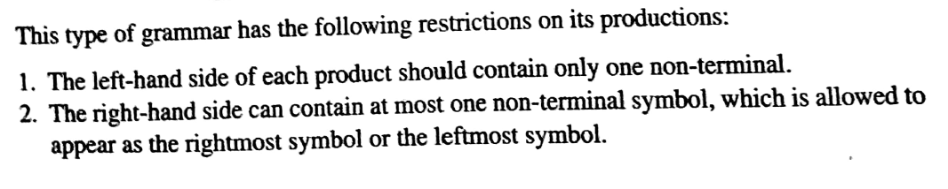

Slide 3
Regular Grammar can be
1. Left Linear Regular Grammar
2. Right Linear Regular Grammar

Slide 4
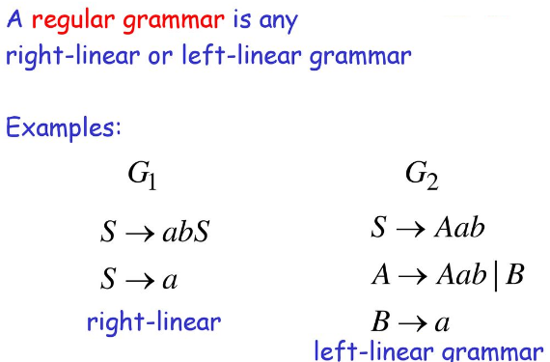

Slide 5
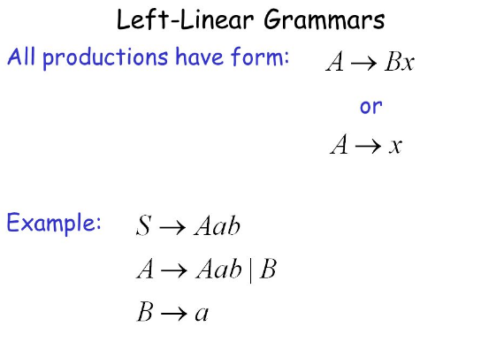

Slide 6
Conversion of Right Linear Regular Grammar to Left Linear Regular Grammar

Slide 7
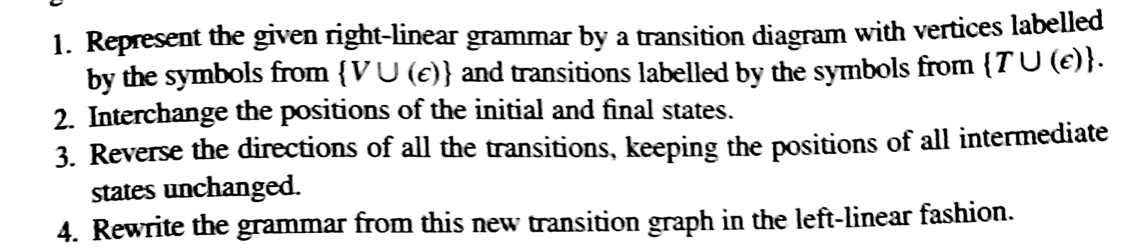
Conversion of RL Grammar to LL Grammar

Slide 8
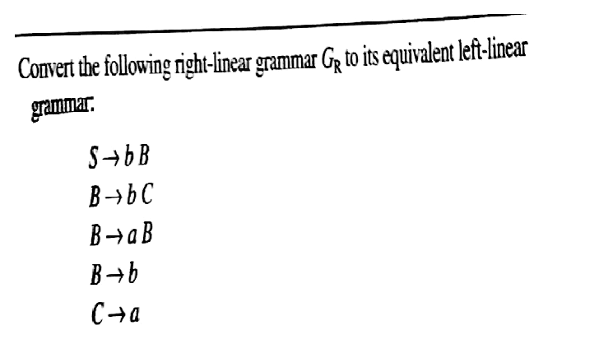
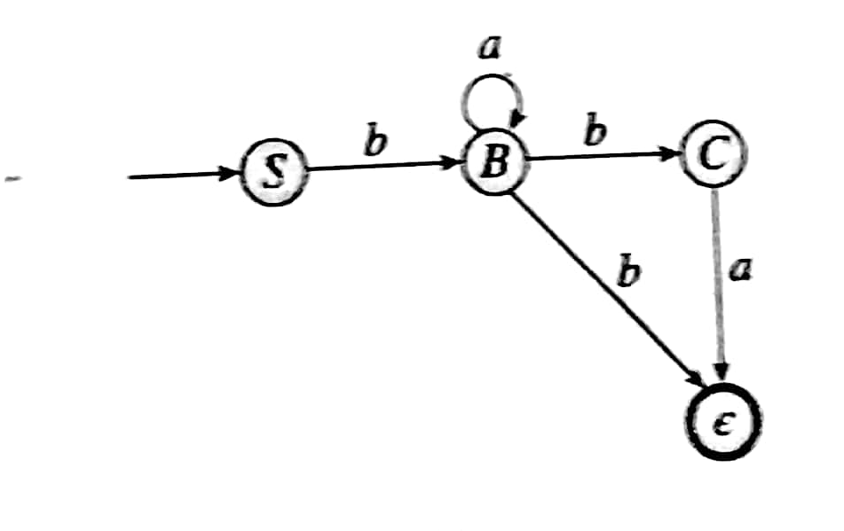

Slide 9
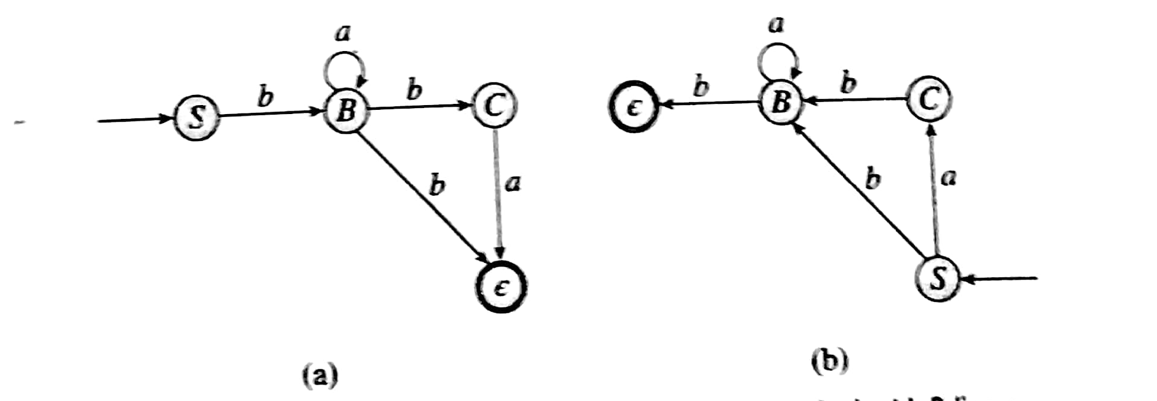
Conversion of RL Grammar to LL Grammar

Slide 10
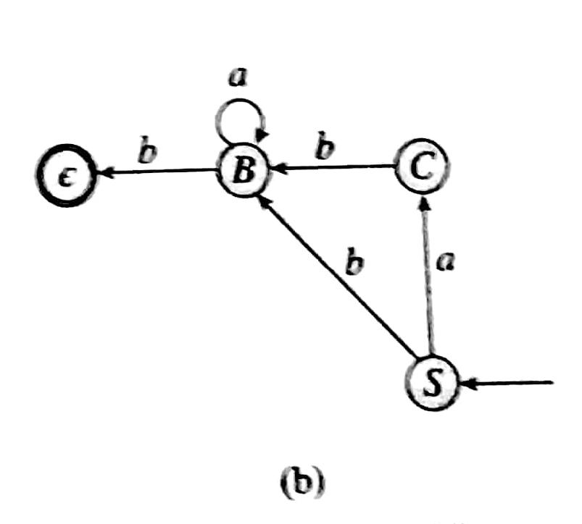
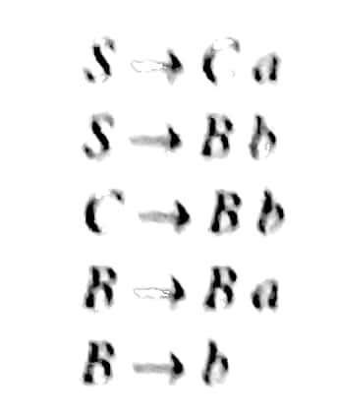

Slide 11
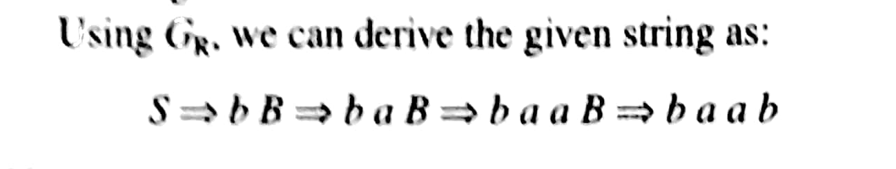
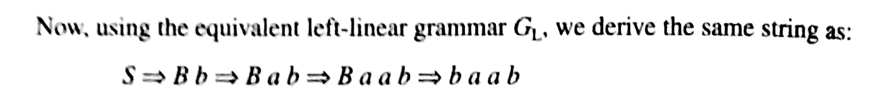
Conversion of RL Grammar to LL Grammar

Slide 12
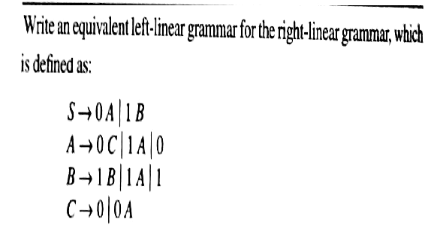

Slide 13
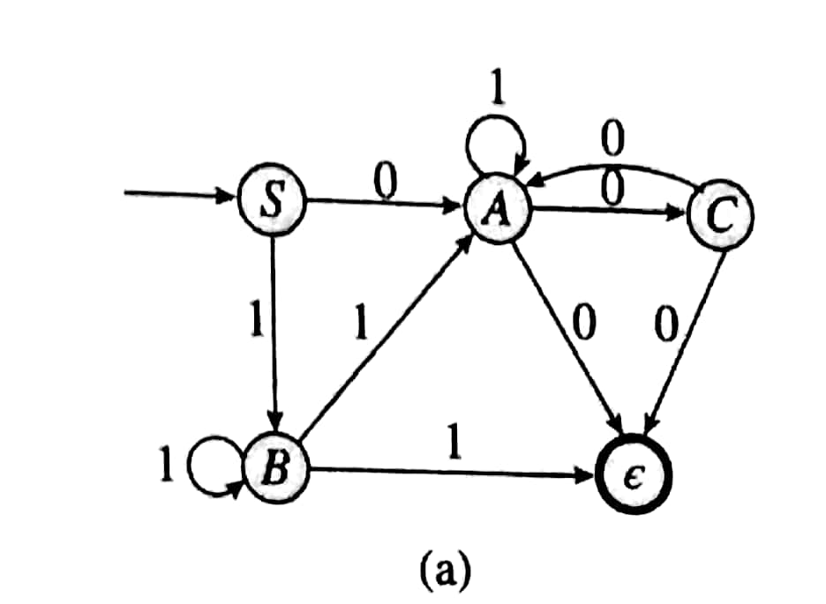
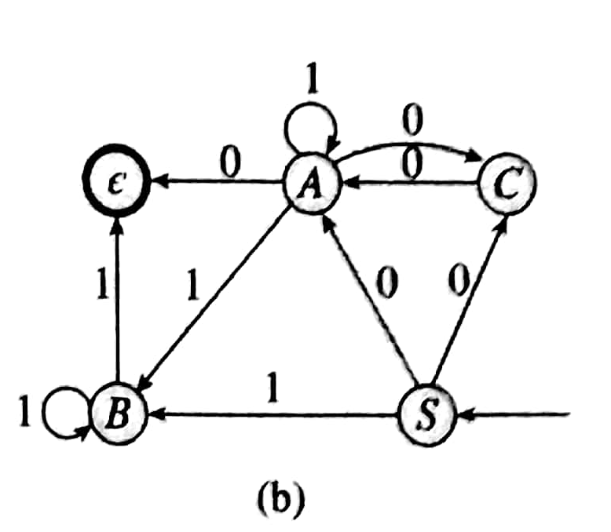

Slide 14
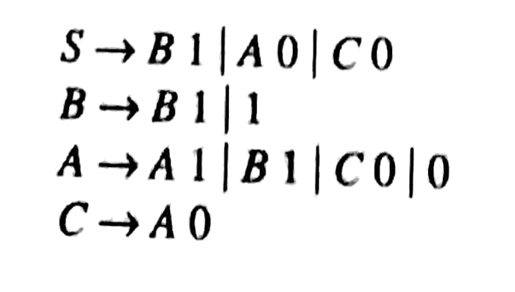

Slide 15
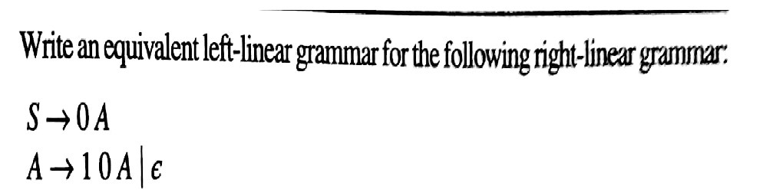

Slide 16
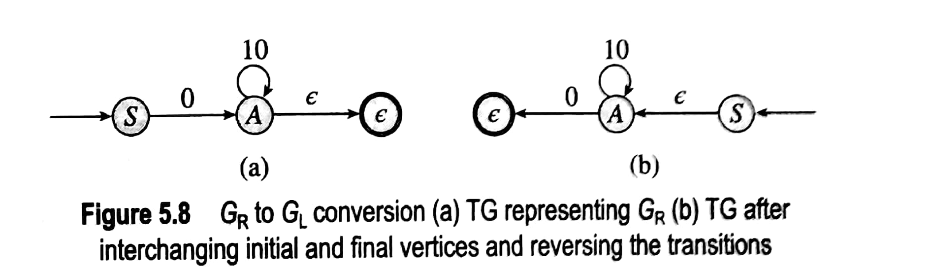

Slide 17
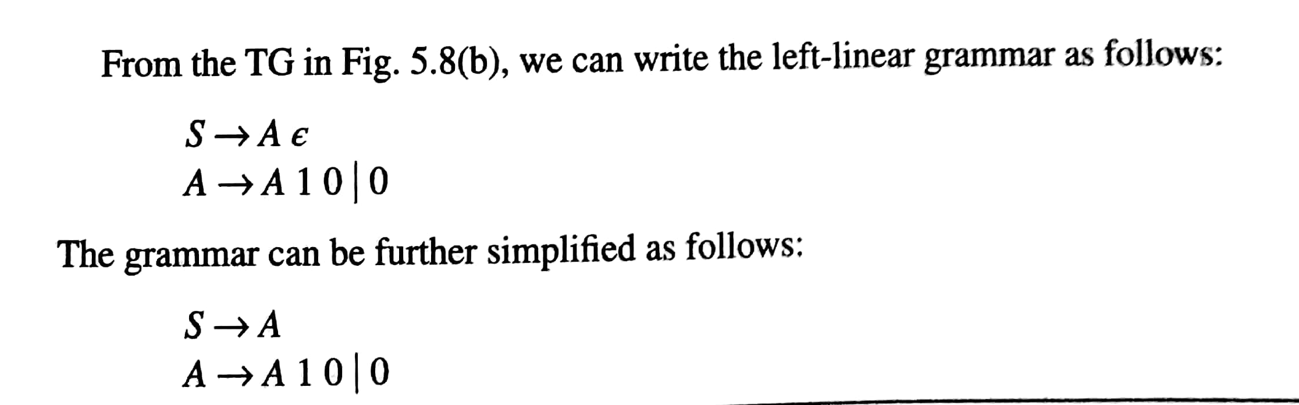

Slide 18
Conversion of Left Linear G to equivalent Right Linear G

Slide 19
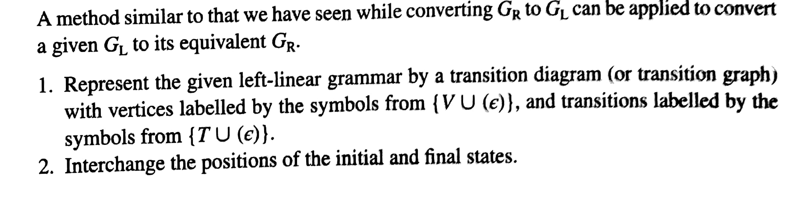
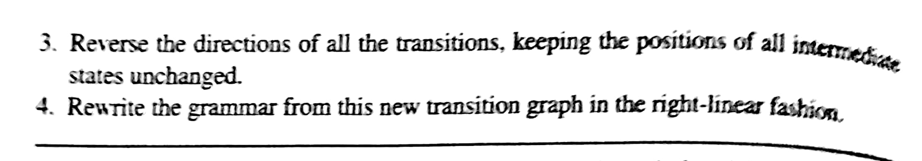
Conversion of LL Grammar to RL Grammar

Slide 20
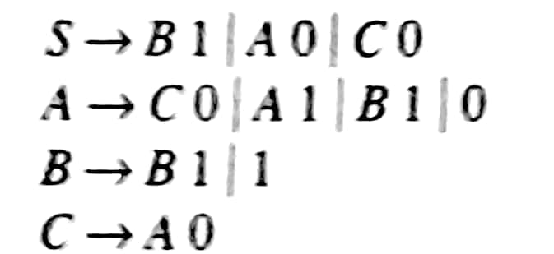
Conversion of LL Grammar to RL Grammar

Slide 21
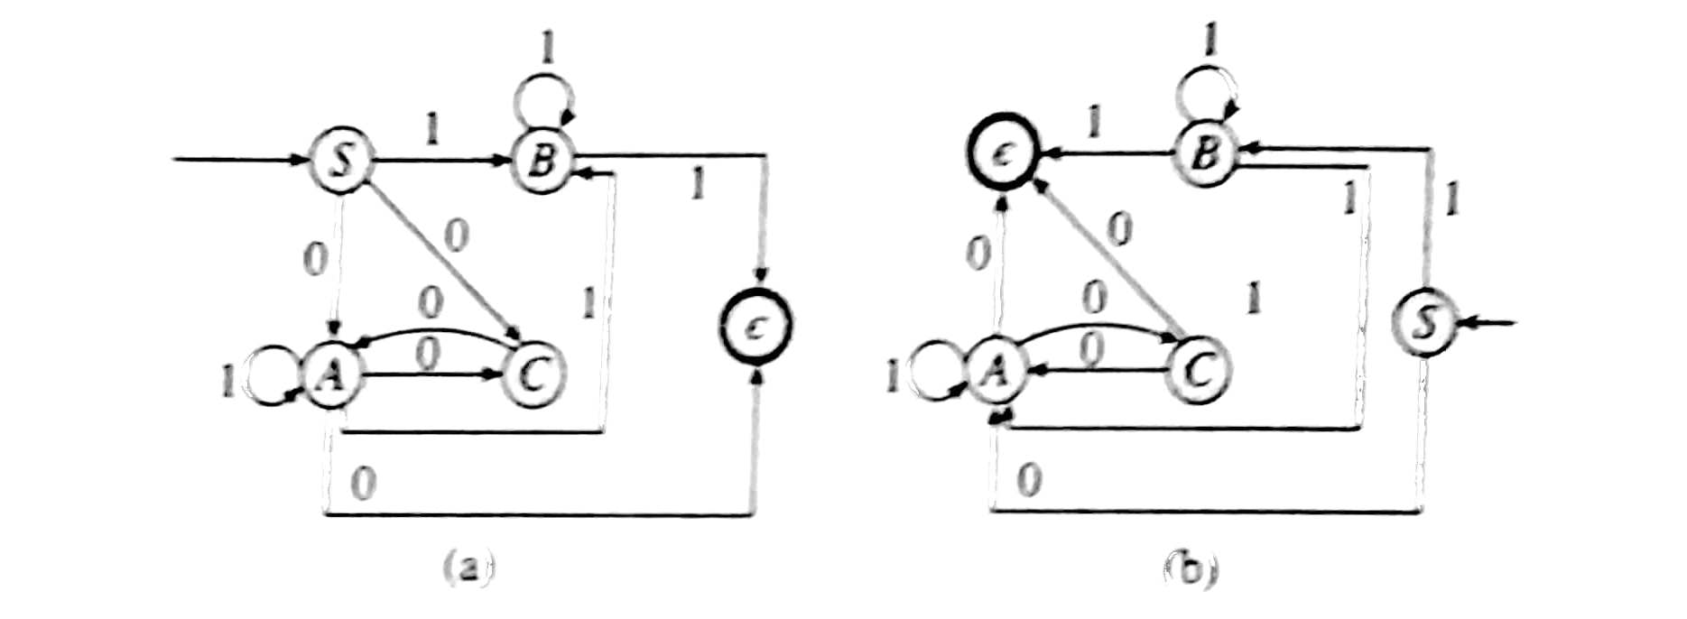
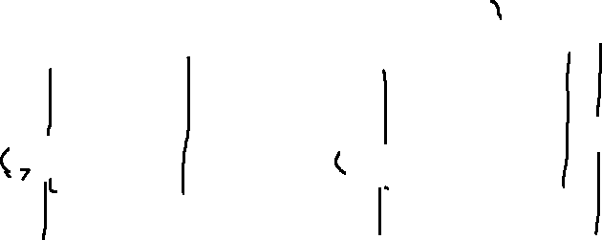
Convert following LL grammar to its equivalent RL grammar

Slide 22
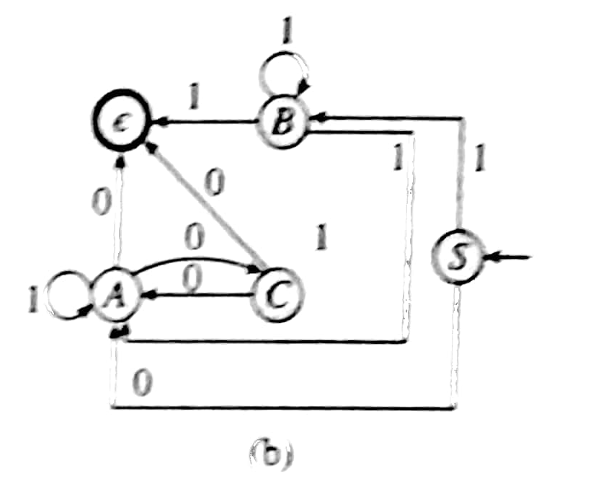
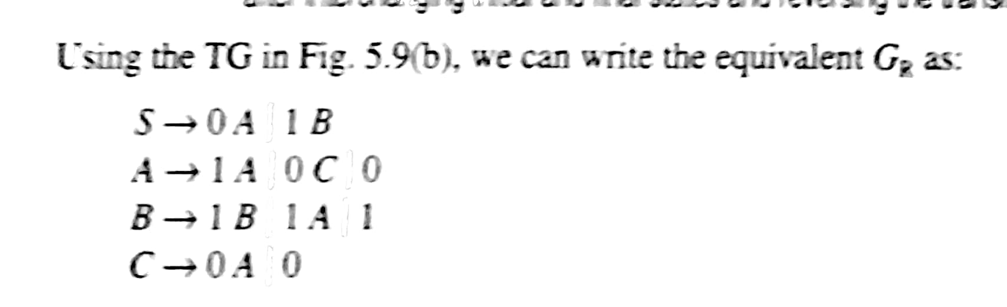
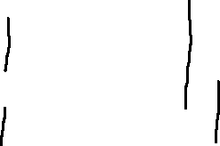

Slide 23
Right Linear G to FA

Slide 24
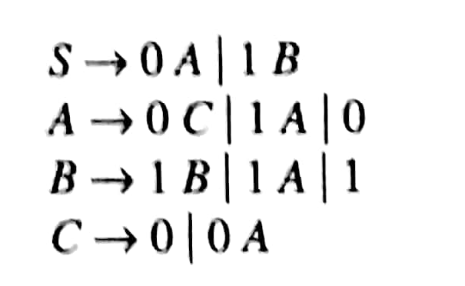

Slide 25
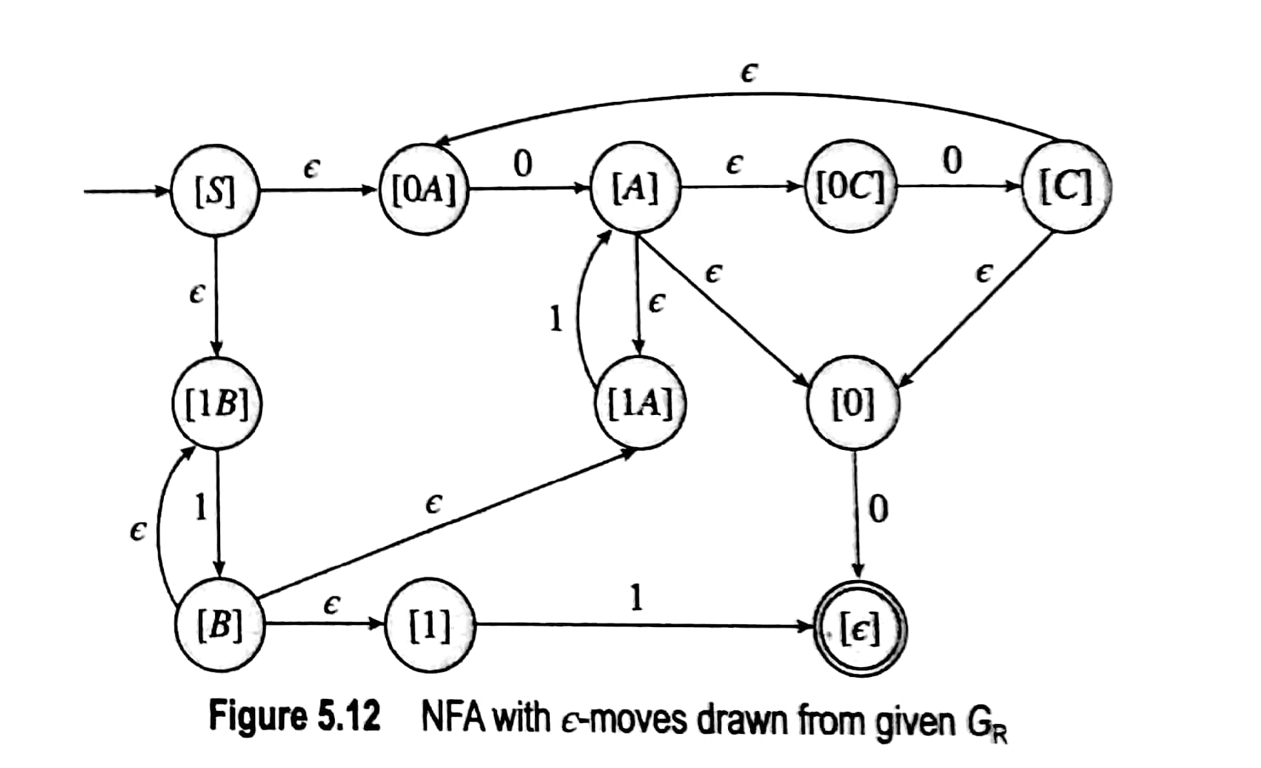

Slide 26
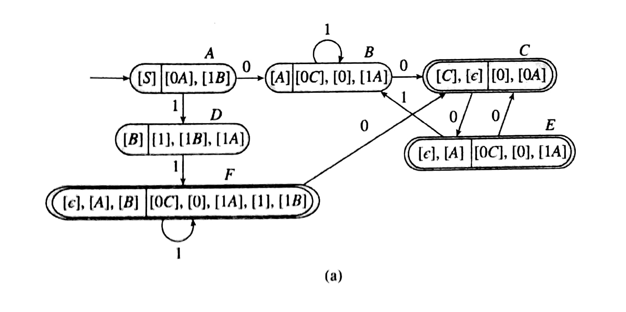

Slide 27
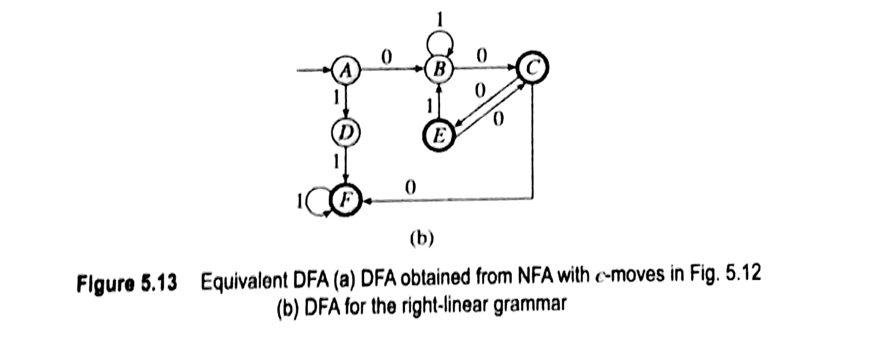
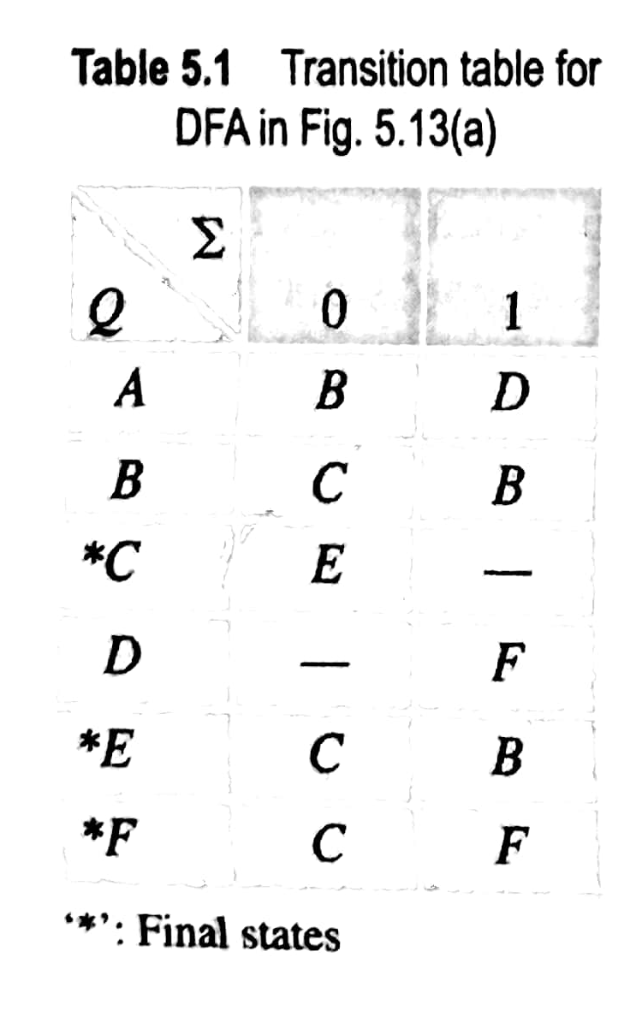
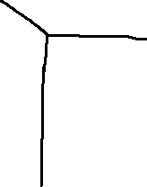

Slide 28
Exercise

Slide 29
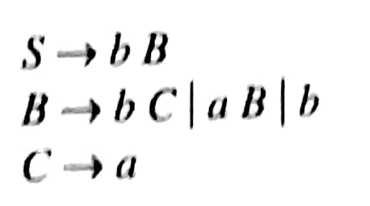
Exercise

Slide 30


Slide 31
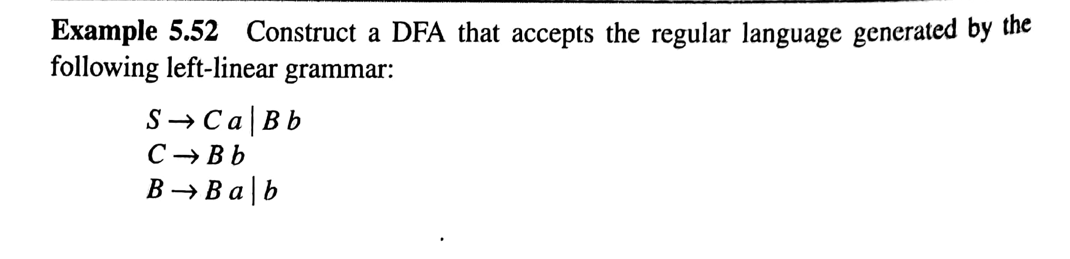
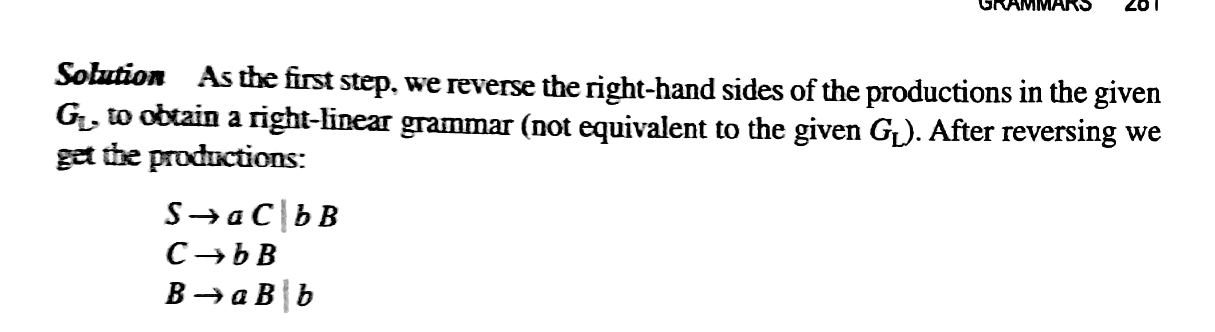

Slide 32
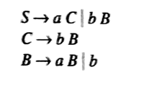
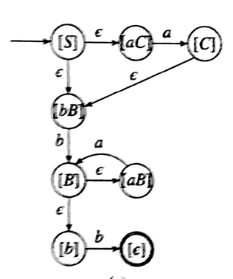
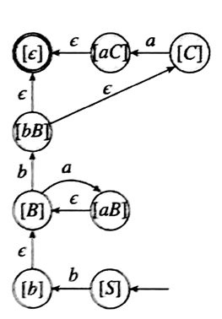
Step 2: Interchange positions of IS and FS and reverse the directions of all transitions.
Step 1: Draw NFA-ε

Slide 33
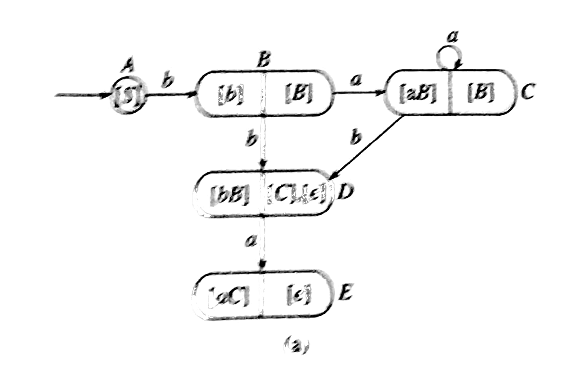
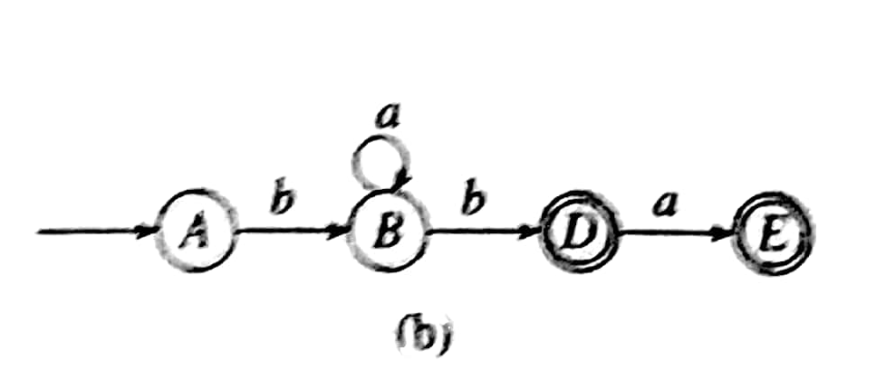
Step 3: Convert the NFA- ε in step step 2 to equivalent DFA
Step 4: Minimize the DFA in step 3 if possible and draw minimized DFA.

Slide 34
Closure properties of CFL

Slide 35
Closure properties of CFL
Context Free languages are accepted by pushdown automata but not by finite automata. Context free languages can be generated by context free grammar which has the form :
A -> ρ (where A ∈ N and ρ ∈ (T ∪ N)* and N is a non-terminal and T is a terminal)

Slide 36
Properties of Context Free Languages

Slide 37
Union
Union : If L1 and If L2 are two context free languages, their union L1 ∪ L2 will also be context free. For example,
L1 = { a^{n}b^{n}c^{m} | m >= 0 and n >= 0 } and L2 = { a^{n}b^{m}c^{m} | n >= 0 and m >= 0 }
L3 = L1 ∪ L2 = { a^{n}b^{n}c^{m} ∪ a^{n}b^{m}c^{m} | n >= 0, m >= 0 } is also context free.
L1 says number of a’s should be equal to number of b’s and L2 says number of b’s should be equal to number of c’s. Their union says either of two conditions to be true. So it is also context free language.
Note: So CFL are closed under Union.

Slide 38
Concatenation
Concatenation : If L1 and If L2 are two context free languages, their concatenation L1.L2 will also be context free. For example,
L1 = { a^{n}b^{n} | n >= 0 } and L2 = { c^{m}d^{m} | m >= 0 }
L3 = L1.L2 = { a^{n}b^{n}c^{m}d^{m} | m >= 0 and n >= 0} is also context free.
L1 says number of a’s should be equal to number of b’s and L2 says number of c’s should be equal to number of d’s. Their concatenation says first number of a’s should be equal to number of b’s, then number of c’s should be equal to number of d’s. So, we can create a PDA which will first push for a’s, pop for b’s, push for c’s then pop for d’s. So it can be accepted by pushdown automata, hence context free.
Note: So CFL are closed under Concatenation.

Slide 39
Kleene Closure :
Kleene Closure : If L1 is context free, its Kleene closure L1* will also be context free. For example,
L1 = { a^{n}b^{n} | n >= 0 }
L1* = { a^{n}b^{n} | n >= 0 }* is also context free.
Note :So CFL are closed under Kleen Closure.

